Slide 1

Spring 2022: Strategic Capstone Final Project
No Show to Appointment
Presenters: Tony & Xuan

Slide 2

agenda
Introduction
Methods
Results
Discussion & Conclusions

Slide 3

introduction
Problem Description
Background
Research questions

Slide 4
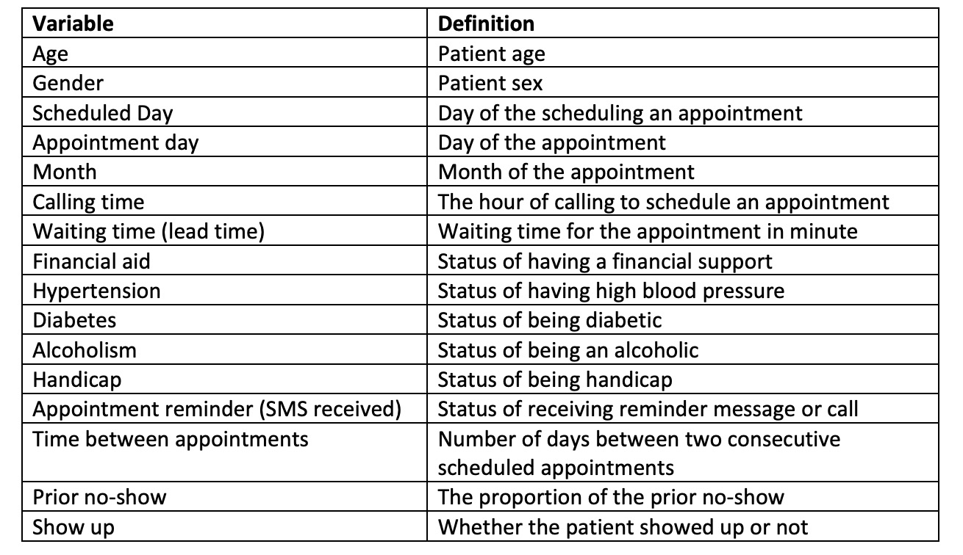
Problem description
In the medical industry, hospitals from around the area are negatively affected by no-show appointments. No-show appointments have been a serious problem that occupies medical resources and wastes a large amount of money and time(Qureshi et al., 2021).

Slide 5
Background: Business understanding
Medical industry
Hospitals
No-show appointment

Slide 6
Research questions
1. Can we predict the variable of interest (response variable) using data analytical techniques?
2. What are the important features in order to predict the response variable?
3. What is the importance of the features?
4. Can we predict the probability of each class (classification problem) for each sample using data analytical techniques?
5. How do the different sampling techniques affect the prediction of the response variable?
6. How do the different feature selection methods affect the prediction of the response variable?
7. How does the prediction performance change for more complex analytical models?
8. What strategy outline do you propose to increase the performance of the specific problem (healthcare, banking, service) you are working on? Or how do you apply the data analysis that you have into practice in order to make data-driven decisions for the business you are studying?

Slide 7

Methods
Data Understanding
Data Preparation
Modeling
Framework

Slide 8
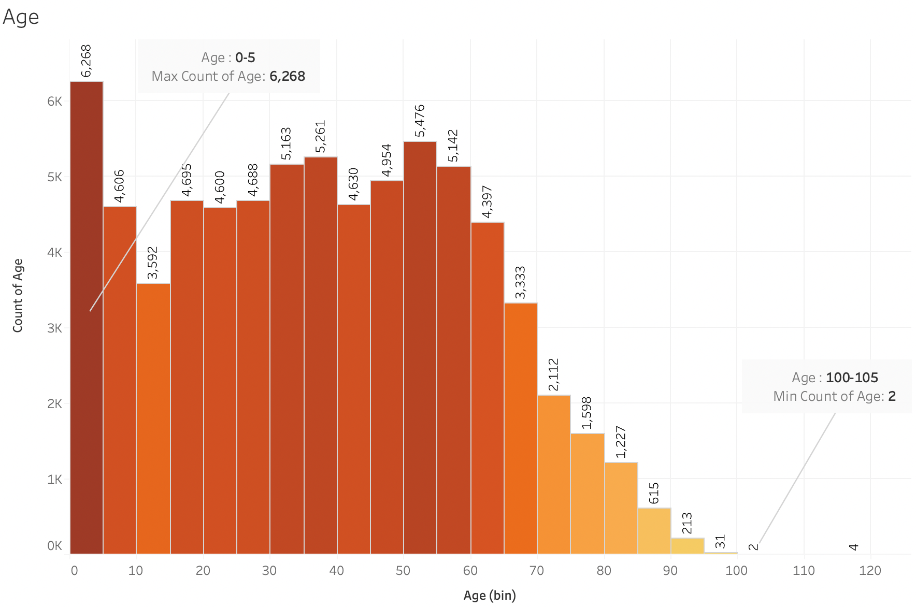
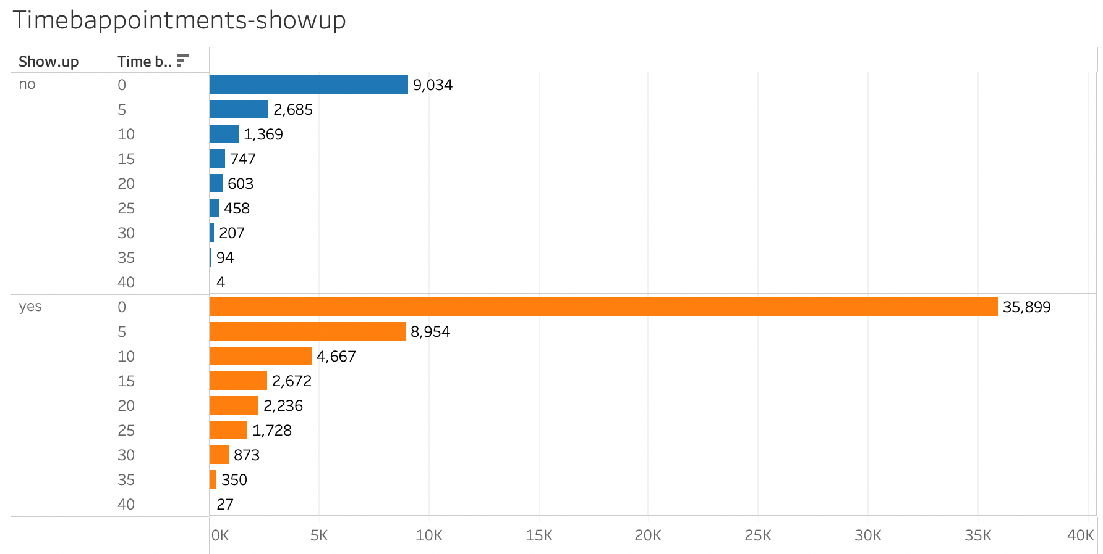
Data understanding
Descriptive statistics
Graphs for each variable and input variables with output through Tableau

Slide 9
Data preparation
Remove redundant features: Patient ID and Appointment ID
Check NA values
Imputation: NA
Check zero/near zero variance
One hot and integer encoding: dummy variables
Binning: Age, Calling_time, Waiting_time, Time_b_appointment, Prior_noshow
Outlier detection: Clustering

Slide 10
modeling
Splitting Train & Test set: 0.75/0.25
Feature selection: Repart and Randomforest
Balancing data: ADASYN 0.85 and BLSMOTE 0.85
Models: GLM, Rpart, Naive Bayes

Slide 11
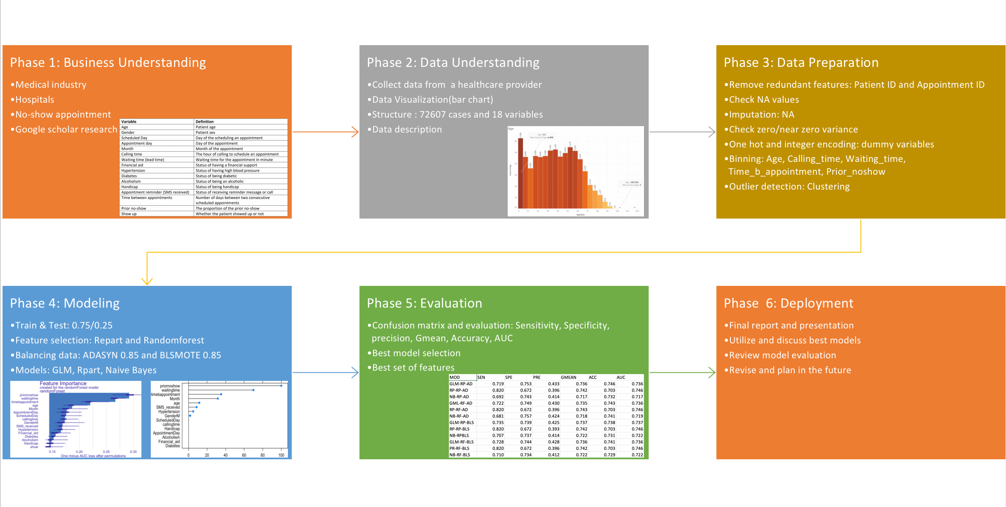
framework

Slide 12

Results

Slide 13
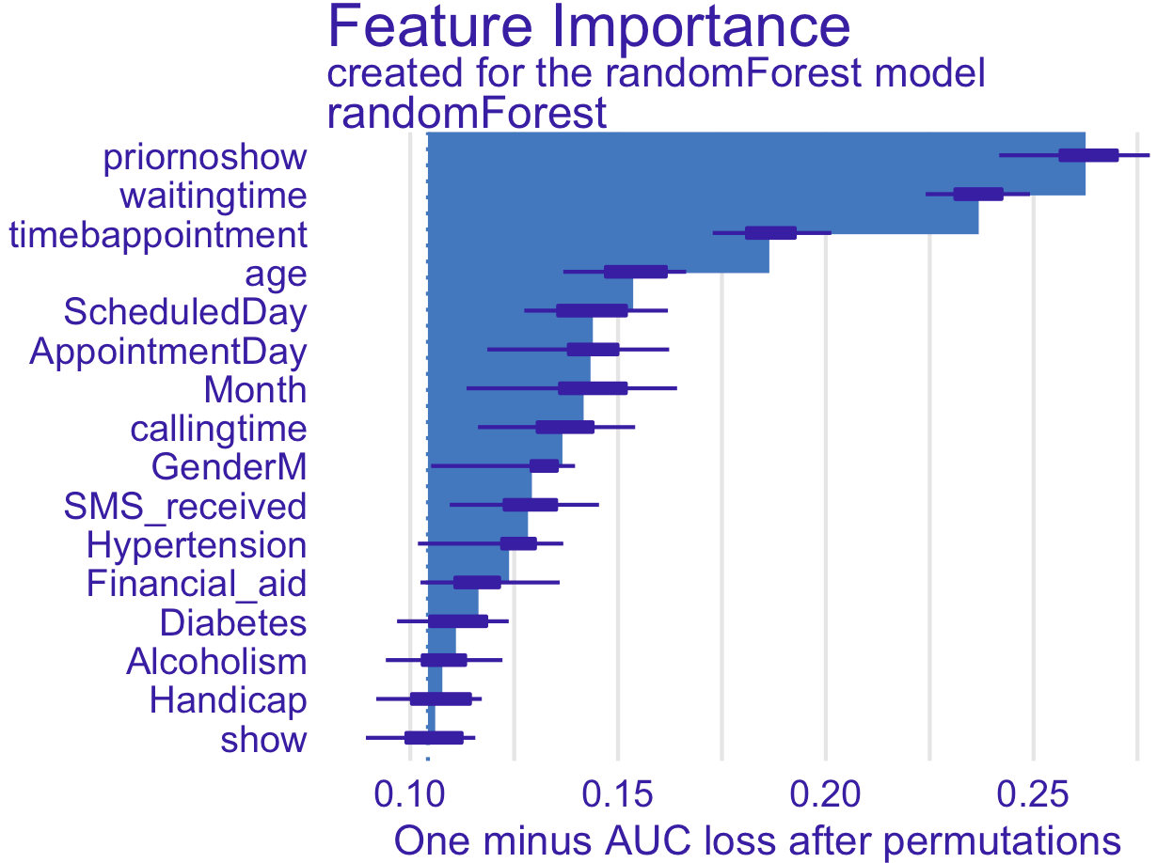
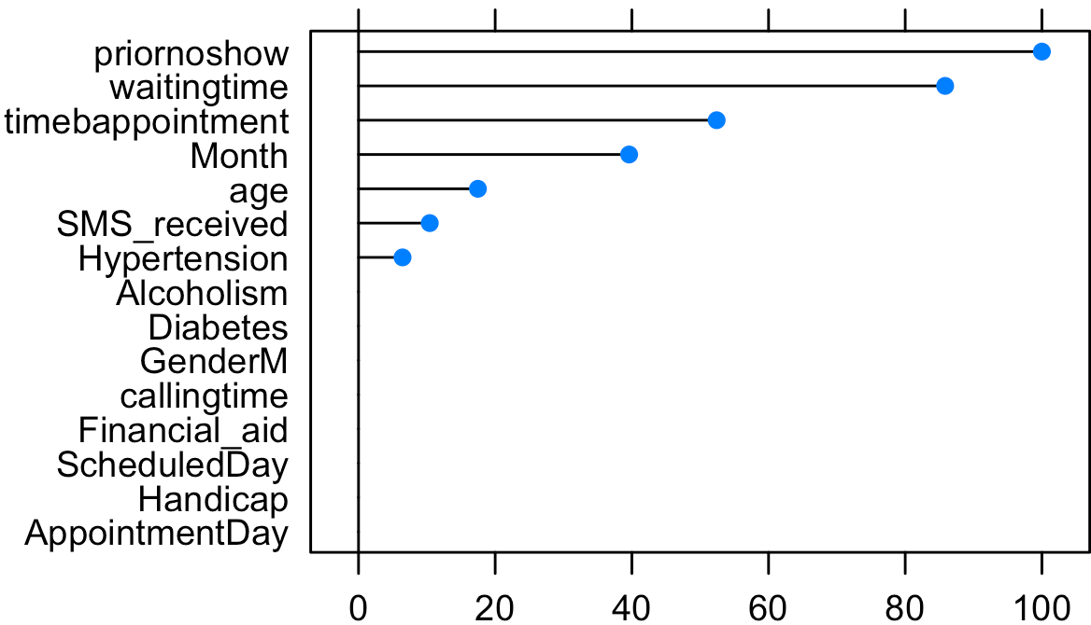
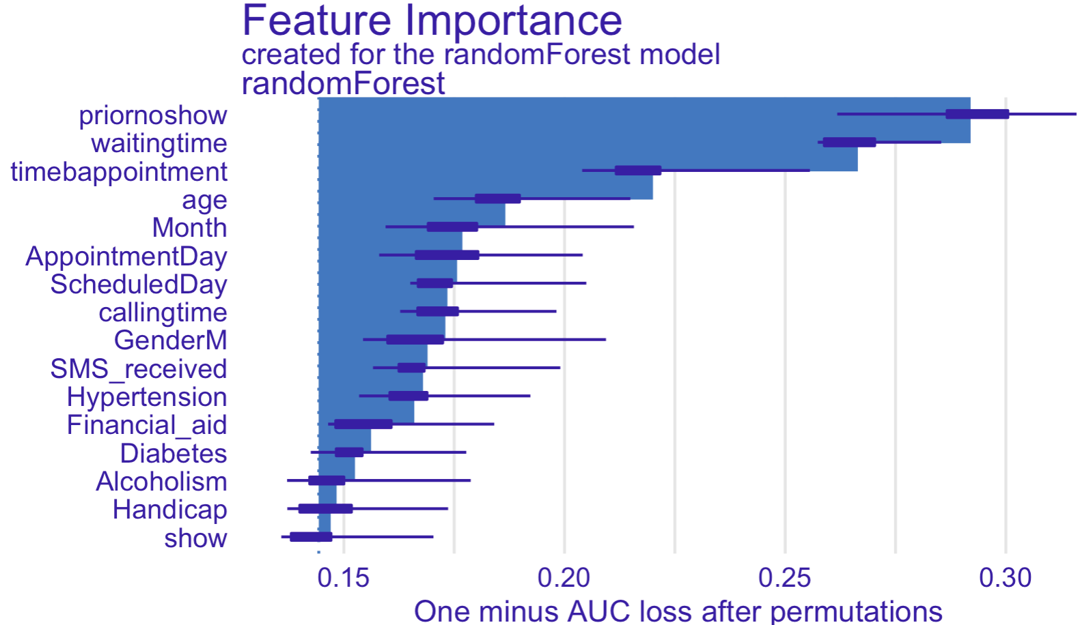
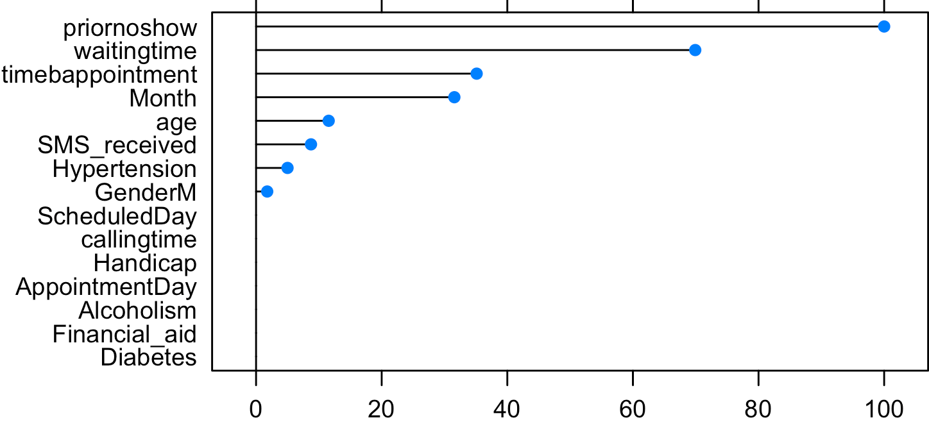
RESULTS
The best set of features: prior no show, waiting time, time between appointment, age, Month, SMS received.

Slide 14
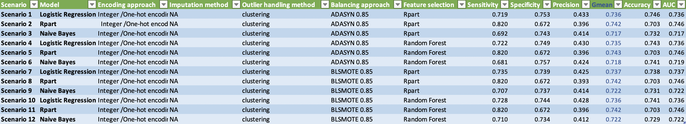
RESULTS
Best model: Logistic regression
Best feature selection: Rpart
Best balancing approach: BLSMOTE

Slide 15
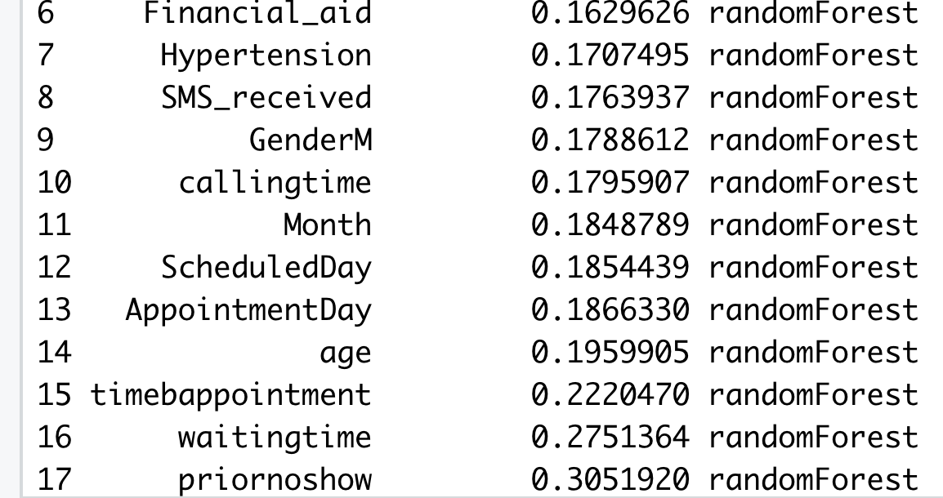
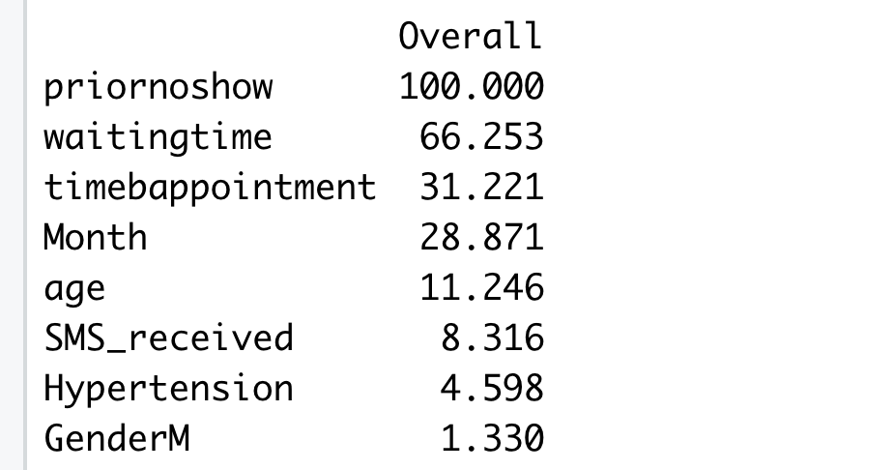
RESULTS
1. Can we predict the variable of interest (response variable) using data analytical techniques? ---- Yes, we can.
2. What are the important features in order to predict the response variable? What is the importance of the features? ---- Prior no show, waiting time, time between appointment, age, Month, SMS received.
3. Can we predict the probability of each class for each sample using data analytical techniques? ---- We could also predict the probability of each class for each sample using a data analytical method like the confusion matrix we got.
4. How do the different sampling techniques and feature selection methods affect the prediction of the response variable? ---- A proper sampling technique or feature selection method may give us better models.
5. How does the prediction performance change for more complex analytical models? ---- More complex analytical models don’t mean that the performance would be better.
6. How do you apply the data analysis that you have into practice in order to make data-driven decisions for the business you are studying? ---- The healthcare center could focus on those factors and have them into practice.

Slide 16

Discussion & conclusions
Best model: the 7th model(logistic regression model with BLSMOTE resampling method and Rpart feature selection)
Best set of features: prior no show, waiting time, time between appointment, age, Month, SMS received
Reduce the time of patients waiting for the appointment and improve the efficiency
Reminder messages or calls before appointments

Slide 17
References
Qureshi, Z., Maqbool, A., Mirza, A., Iqbal, M. Z., Afzal, F., Kanubala, D. D., Rana, T., Umair, M. Y., Wakeel, A., & Shah, S. K. (2021). Efficient prediction of missed clinical appointment using machine learning. Computational and Mathematical Methods in Medicine, 2021, 1–10. https://doi.org/10.1155/2021/2376391
Batool, T., Abuelnoor, M., Boutari, O. E., Aloul, F., & Sagahyroon, A. (2020). Hub: Predicting hospital no-shows using machine learning. 2020 IEEE International Conference on Internet of Things and Intelligence System (iotais): 10.1109/iotais50849.2021.9359692. Sci. Retrieved April 2, 2022, from https://sci-hub.hkvisa.net/10.1109/iotais50849.2021.9359692

Slide 18
Thanks for Listening

